Slide 1


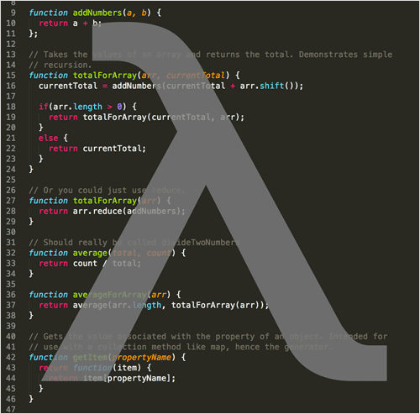

Stream API
Working with the Stream API
Advanced Java
SoftUni Team
SoftUni Team
Technical Trainers
Technical Trainers
Software University
Software University
http://softuni.bg

Slide 2

Table of Contents
Stream<T> Class
Types of Streams in Stream API
Generic, Primitive
Types of Stream Operations
Intermediate, Terminal
Map, Filter, Reduce
Streams on Maps
Collectors

Slide 3
Questions
sli.do #JavaFundamentals

Slide 4
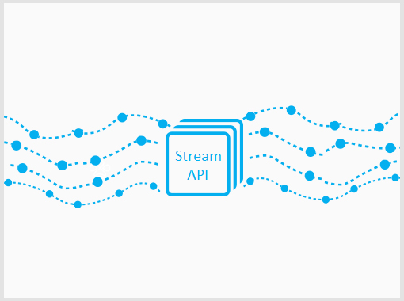

Stream API
Traversing and Querying Collections

Slide 5
Stream API and Stream<T> Class
Querying a collection in a functional way
Get an instance through:
A List:
An Array:
List<Integer> list = new ArrayList<>();
Stream<Integer> stream = list.stream();
String[] array = new String[10];
Stream<String> stream = Arrays.stream(array);

Slide 6
Stream<T> Class (2)
Methods are chained
Get an instance through:
A Hash Map :
HashMap<String, String> map = new HashMap<>();
Stream<Map.Entry<String, String>> entries = map.entrySet().stream();
Stream<String> keys = map.keySet().stream();
Stream<String> keys = map.values().stream();

Slide 7
Problem: Take Two
Create a program that:
Reads a sequence of integers
Finds all unique elements, such that 10 ≤ n ≤ 20
Prints only the first 2 elements
15
2
15
14
12
15
14
Check your solution here: https://judge.softuni.bg/Contests/Practice/Index/465#0

Slide 8
Solution: Take Two – Non Functional
LinkedHashSet<Integer> set = // create set
for (Integer number : numbers) {
if (set.size() >= 2) {
break;
if (10 <= number && number <= 20) {
set.add(number);
}
Check your solution here: https://judge.softuni.bg/Contests/Practice/Index/465#0

Slide 9
Solution: Take Two – Functional
numbers.stream()
.filter(n -> 10 <= n && n <= 20)
.distinct()
.limit(2)
.forEach(n -> print(n));
Check your solution here: https://judge.softuni.bg/Contests/Practice/Index/465#0

Slide 10
Function Execution
Each function call creates a new Stream<T> instance
This allows method chaining
List<String> strings = new ArrayList<>();
Stream<String> stringStream = strings.stream();
Stream<Integer> intStream = stringStream.map(s -> s.length());

Slide 11
Function Execution (2)
Execution is "Lazy"
List<Integer>
10
2
5
2
stream()
10
2
5
2
filter(x -> x > 4)
10
2
5
2
map(x -> x * 2)
20
10
forEach(print(x))
20
10

Slide 12

So What is a Stream?
Stream is not a collection and doesn't store any data
Stream iterates over a collection
Does not modify the data it processes
2
5
10
2
5
10

Slide 13

Stream Types and Optionals
Generic and Primitive Streams

Slide 14
Generic Streams
Can be of any type except primitives
List<String> strings = new ArrayList<>();
Stream<String> strStream = strings.stream();
List<Integer> ints = new ArrayList<>();
Stream<Integer> intStream = ints.stream();
List<Object> objects = new ArrayList<>();
Stream<Object> objStream = objects.stream();

Slide 15
Problem: UPPER STRINGS
Read a sequence of strings
Map each to upper case and print them
Use the Stream API
Pesho Gosho Stefan
PESHO GOSHO STEFAN
Soft Uni Rocks
SOFT UNI ROCKS
Check your solution here: https://judge.softuni.bg/Contests/Practice/Index/465#0

Slide 16
Solution: UPPER STRINGS
Scanner scanner = new Scanner(System.in);
List<String> strings = Arrays.asList( scanner
.nextLine()
.split("\\s+"));
strings.stream()
.map(s -> s.toUpperCase())
.forEach(s -> System.out.print(s + " "));
Check your solution here: https://judge.softuni.bg/Contests/Practice/Index/465#0

Slide 17
Optional<T>
Some functions can return Optional<T>
Optional<String> first = elements.stream()
.sorted()
.findFirst();
if (first.isPresent()) {
System.out.println(first.get());
else
System.out.println("No matches.");
Check if optional has value
Gets the value

Slide 18
Problem: First Name
Read a sequence of names
Read a sequence of letters
Of the names that start with one of the letters find the first name (ordered lexicographically)
Rado Plamen Gosho
p r
Plamen
Plamen Gosho Rado
s c
No match
Check your solution here: https://judge.softuni.bg/Contests/Practice/Index/465#0

Slide 19
Solution: First Name
List<String> names = Arrays.asList( scanner.nextLine().split("\\s+"));
HashSet<Character> letters = new HashSet<>();
Stream.of(scanner.nextLine().split("\\s+"))
.map(s -> s.toLowerCase().charAt(0))
.forEach(c -> letters.add(c));
Check your solution here: https://judge.softuni.bg/Contests/Practice/Index/465#0

Slide 20
Solution: First Name (2)
Optional<String> first = names.stream()
.filter(s -> letters.contains(s.toLowerCase().charAt(0)))
.sorted()
.findFirst();
if (first.isPresent())
System.out.println(first.get());
else
System.out.println("No match");
Check your solution here: https://judge.softuni.bg/Contests/Practice/Index/465#0

Slide 21
Primitive Streams
Work efficiently with primitive types
Give access to additional functions
int[] ints = { 1, 2, 3, 4 };
IntStream intStream = IntStream.of(ints);
List<Integer> list = new ArrayList<>();
IntStream mappedIntStream = list.stream()
.mapToInt(n -> Integer.valueOf(n));

Slide 22
Problem: Average of Doubles
Read a sequence of double numbers
Find the average of all elements
Use the Stream API
Round to second digit
3 4 5 6
4.50
3.14 5.2 6.18
4.84
(empty sequenece)
No match
Check your solution here: https://judge.softuni.bg/Contests/Practice/Index/465#0

Slide 23
Solution: Average of Doubles
OptionalDouble average = elements.stream()
.fiter(n -> !n.isEmpty())
.mapToDouble(Double::valueOf)
.average();
if (average.isPresent())
System.out.printf( "%.2f", average.getAsDouble());
else
System.out.println("No match");
Gets the value
Check your solution here: https://judge.softuni.bg/Contests/Practice/Index/465#0

Slide 24

Practice: Stream<T> and Primitive Streams
Live Exercises in Class (Lab)

Slide 25


Types of Operations
Intermediate, Terminal

Slide 26
Intermediate Operations
Do not terminate the Stream
List<String> elements = new ArrayList<>();
Collections.addAll(elements, "one", "two");
Stream<String> stream = elements.stream()
.distinct()
.sorted()
.filter(s -> s.length() < 5)
.skip(1)
.limit(1);
All return a new Stream
Allow function chaining

Slide 27
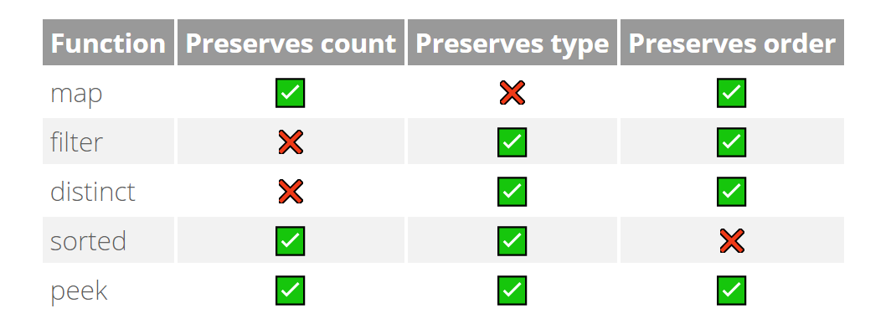
Intermediate Operations (2)
Some of the intermediate operations

Slide 28
Terminal Operations
Terminate the stream
List<String> elements = new ArrayList<>();
Collections.addAll(elements, "one", "two");
elements.stream()
.distinct()
.forEach(s -> System.out.println(s))
Closes the stream

Slide 29
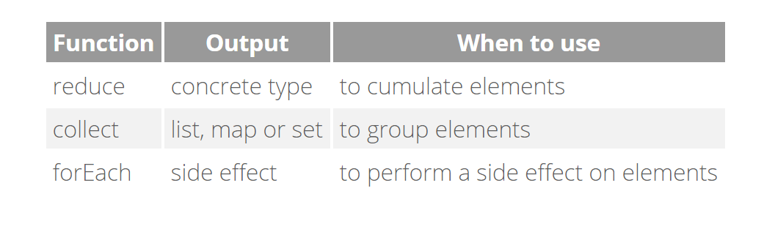
Terminal Operations (2)
Useful terminal operations:

Slide 30

Types of Operations
Map, Filter, Reduce

Slide 31
Map, Filter, Reduce
Common pattern in data querying
List<String>
"10"
"2"
"5"
"6"
.mapToInt(Integer::valueOf())
10
2
5
6
.filter(x -> x > 4)
10
5
6
10
5
6
21
.reduce((x, y) -> x + y)
15

Slide 32
Map Operations
Transform the objects in the stream
Stream<String> strStream =
Stream.of("1", "2", "3");
Stream<Integer> numStream = strStream.map(Integer::valueOf);
Transforms the stream

Slide 33
Filter Operations
Filter objects by a given predicate
Stream<String> strStream = Stream.of("one", "two", "three")
.filter(s -> s.length() > 3);
Preserves strings longer that 3

Slide 34
Reduce Operations
Check for a given condition:
Any element matches:
All elements match:
None of the elements match:
Short circuit operations
Short circuit operations
boolean any = stream1.anyMatch(x -> x % 2 == 0);
boolean all = stream2.allMatch(x -> x % 2 == 0);
boolean none = stream3.noneMatch(x -> x % 2 == 0);

Slide 35
Find Reductions
Find an element:
Gets the first element of the stream:
Gets any element of the stream:
Optional<Integer> first = list.stream() .findFirst();
Optional<Integer> first = list.stream() .findAny();

Slide 36
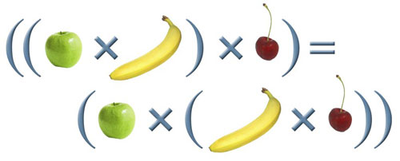
General Reduction
Applies а given lambda:
Consider associativity:
Optional<Integer> first = list.stream() .reduce((x, y) -> x + y);
r(a, r(b, c)) should be equal to r(r(a, b), c)

Slide 37
Problem: Min Even Number
Read a sequence of numbers
Find the min of all even numbers
Use the Stream API
1 2 3 4 5 6
2.00
3.14 -2.00 1.33
-2.00
(empty list)
No match
Check your solution here: https://judge.softuni.bg/Contests/Practice/Index/465#0

Slide 38
Solution: Min Even Number
Optional<Double> min = Arrays.stream( scanner.nextLine().split("\\s+"))
.filter(n -> !n.isEmpty())
.map(Double::valueOf)
.filter(n -> n % 2 == 0)
.min(Double::compare);
Check your solution here: https://judge.softuni.bg/Contests/Practice/Index/465#0

Slide 39
Problem: Find and Sum Integers
Read a sequence of elements
Find the sum of all integers
Use the Stream API
Sum 3 and 4
7
Sum -3 and -4
-7
Sum three and four
No match
Check your solution here: https://judge.softuni.bg/Contests/Practice/Index/465#0

Slide 40
Solution: Find and Sum Integers
Optional<Integer> sumOfIntsGT20 = Arrays.stream( scanner.nextLine().split("\\s+"))
.filter(x -> isNumber(x))
.map(Integer::valueOf)
.reduce((x1, x2) -> x1 + x2);
Implement boolean method
Check your solution here: https://judge.softuni.bg/Contests/Practice/Index/465#0

Slide 41
Sorting
Sort by passing a comparator as lambda:
List<Integer> numbers = new ArrayList<>();
Collections.addAll(numbers, 7, 6, 3, 4, 5);
numbers.stream()
.sorted((x1, x2) -> Integer.compare(x1, x2)) .forEach(System.out::println);
(x2, x1) for descending order

Slide 42


Streams on HashMaps
Creating a Stream over a HashMap

Slide 43
Creating the Stream
Use any dimension of the Hash Map:
Stream over the Entry set:
Stream over the Key set:
Stream over the Value set:
Stream<Map.Entry<String, String>> entries = map.entrySet().stream();
Stream<String> keys = map.keySet().stream();
Stream<String> keys = map.values().stream();

Slide 44
Problem: Map Districts
You are given population count of districts in different cities
Print all cities with population greater than a given bound
Print top 5 districts for a given city
Sort cities and districts by descending population
Pld:9 Pld:13 Has:7 Sof:20 Sof:10 Sof:15
10
Population greater than 10
Sof: 20 15 10
Pld: 13 9
Check your solution here: https://judge.softuni.bg/Contests/

Slide 45
Solution: Map Districts
HashMap<String, List<Integer>> cities = // init map
// TODO: Read data
u
cities.entrySet().stream()
.filter(getFilterByPopulationPredicate(bound))
.sorted(getSortByDescendingPopulationComparator())
.forEach(getPrintMapEntryConsumer());
Check your solution here: https://judge.softuni.bg/Contests/Practice/Index/465#0

Slide 46
Solution: Map Districts (2)
// Filter by Population Predicate
return kv -> (kv.getValue().stream()
.mapToInt(Integer::valueOf)
.sum()) >= bound;
// Sort by Descending Population Comparator
return (kv1, kv2) -> Integer.compare(
kv2.getValue().stream().mapToInt(Integer::valueOf).sum(),
kv1.getValue().stream().mapToInt(Integer::valueOf).sum()
);
Check your solution here: https://judge.softuni.bg/Contests/Practice/Index/465#0

Slide 47
Solution: Map Districts (3)
// Print Map Entry Consumer
return kv -> {
System.out.print(kv.getKey() + ": ");
kv.getValue().stream()
.sorted((s1, s2) -> s2.compareTo(s1))
.limit(5)
.forEach(dp -> System.out.print(dp + " "));
System.out.println();
};
Check your solution here: https://judge.softuni.bg/Contests/Practice/Index/465#0

Slide 48





Collectors
Materializing a Stream

Slide 49

Collectors
Collecting a Stream into a list:
You can collect streams into different collections:
Arrays, Sets, HashMaps, etc.
String[] strings = { "22", "11", "13" };
List<Integer> numbers = Arrays.stream(strings)
.map(Integer::valueOf)
.collect(Collectors.toList());

Slide 50
Problem: Bounded Numbers
Read a lower and upper bound
Read a sequence of numbers
Print all numbers, such that lower bound ≤ n ≤ upper bound
5 7
1 2 3 4 5 6 7 8 9
7 5
9 5 7 2 6 8
5 6 7
5 7 6
Check your solution here: https://judge.softuni.bg/Contests/Practice/Index/465#0

Slide 51
Solution: Bounded Numbers
Scanner scanner = new Scanner(System.in);
List<Integer> bounds = Arrays.stream(scanner.nextLine().split("\\s+"))
.map(Integer::valueOf)
.collect(Collectors.toList());
// continues…
Check your solution here: https://judge.softuni.bg/Contests/Practice/Index/465#0

Slide 52
Solution: Bounded Numbers (2)
List<Integer> numbers = Arrays.stream(scanner.nextLine().split("\\s+"))
.map(Integer::valueOf)
.filter(x -> Collections.min(bounds) <= x && x <= Collections.max(bounds))
.collect(Collectors.toList());
Check your solution here: https://judge.softuni.bg/Contests/Practice/Index/465#0

Slide 53





Types of Operations
Live Exercises in Class (Lab)

Slide 54
Summary
Stream API is used to traverse and query collections
Streams have "lazy" execution
Streams can be Generic or Primitive
Types of Operations
Intermediate, Terminal
Mapping, Filtering and Reducing
Sorting
Streams can be collected into a collection

Slide 55







Stream API
https://softuni.bg/courses/

Slide 56





Trainings @ Software University (SoftUni)
Software University – High-Quality Education, Profession and Job for Software Developers
softuni.bg
Software University Foundation
http://softuni.foundation/
Software University @ Facebook
facebook.com/SoftwareUniversity
Software University Forums
forum.softuni.bg

